Slide 1

Domain Adversarial Training
신경망응용및실습
Daehyun Cho
Cognitive System Lab
A.I. Dept, Korea Univ.
2021-12-04
1

Slide 2

Index
1
Project Overview
2
Motivation
3
Related Works & Links
4
Detailed Usage
+
Backups
Cogsys Lab

Slide 3
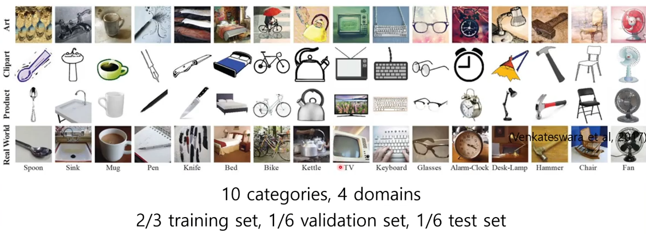
Domain Generalization
Train classification task of different datasets of styles.
3
Further Implemented …
Cogsys Lab, Daehyun Cho

Slide 4
Thank you 🙏
https://github.com/1pha/DomainGeneralization
Daehyun Cho
Cogsys Lab, AI Dept
1phantasmas@korea.ac.kr
Cogsys Lab

Slide 5
+
Backups
__unused slides
Cogsys Lab

